Slide 1
IMPACT OF INTEREST RATE CHANGES ON SECTOR STOCKS & REAL ESTATE MARKETS
Daniel Lott

Slide 2
Data at a Glance
11 ETFs (2006-2025, daily prices)
Fed-Funds Rate & 30-yr Mortgage Rate
Zillow ZHVI for FL & AZ

Slide 3
Research Questions
How do FFR changes affect stock market sector returns?
How do rates affect Florida and Arizona housing?
How can NPV and IRR be applied to analyze these relationships?

Slide 4
Methodology Snapshot
Merged financial data (sector returns, Fed rates, mortgage rates, housing prices) for analysis
Measured how sector returns and housing prices respond to rate changes using regression, assessed significance
Built a rental property cash-flow model to calculate NPV across different mortgage scenarios
Used IRR to estimate investment impact at 3%, 5%, and 7% mortgage rates
Compared results across Florida and Arizona

Slide 5
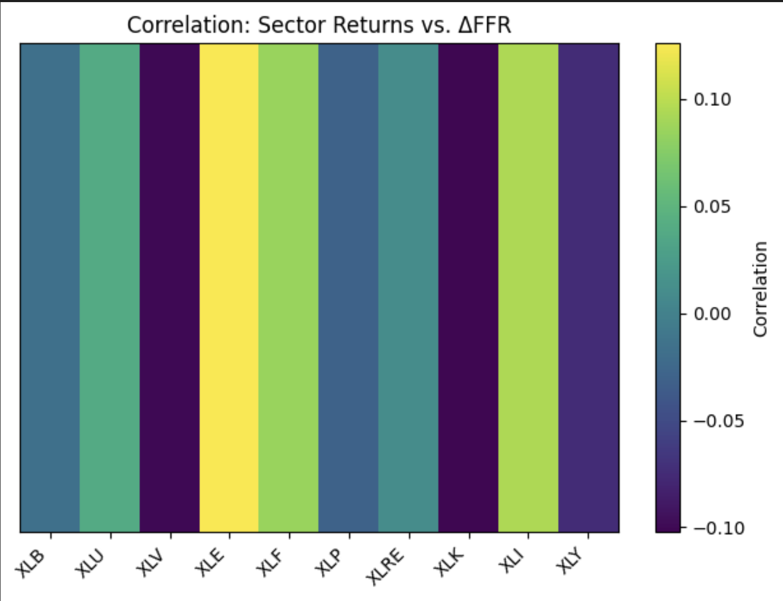
Sector-Rate Correlations
Energy positive correlation
Tech negative correlation

Slide 6
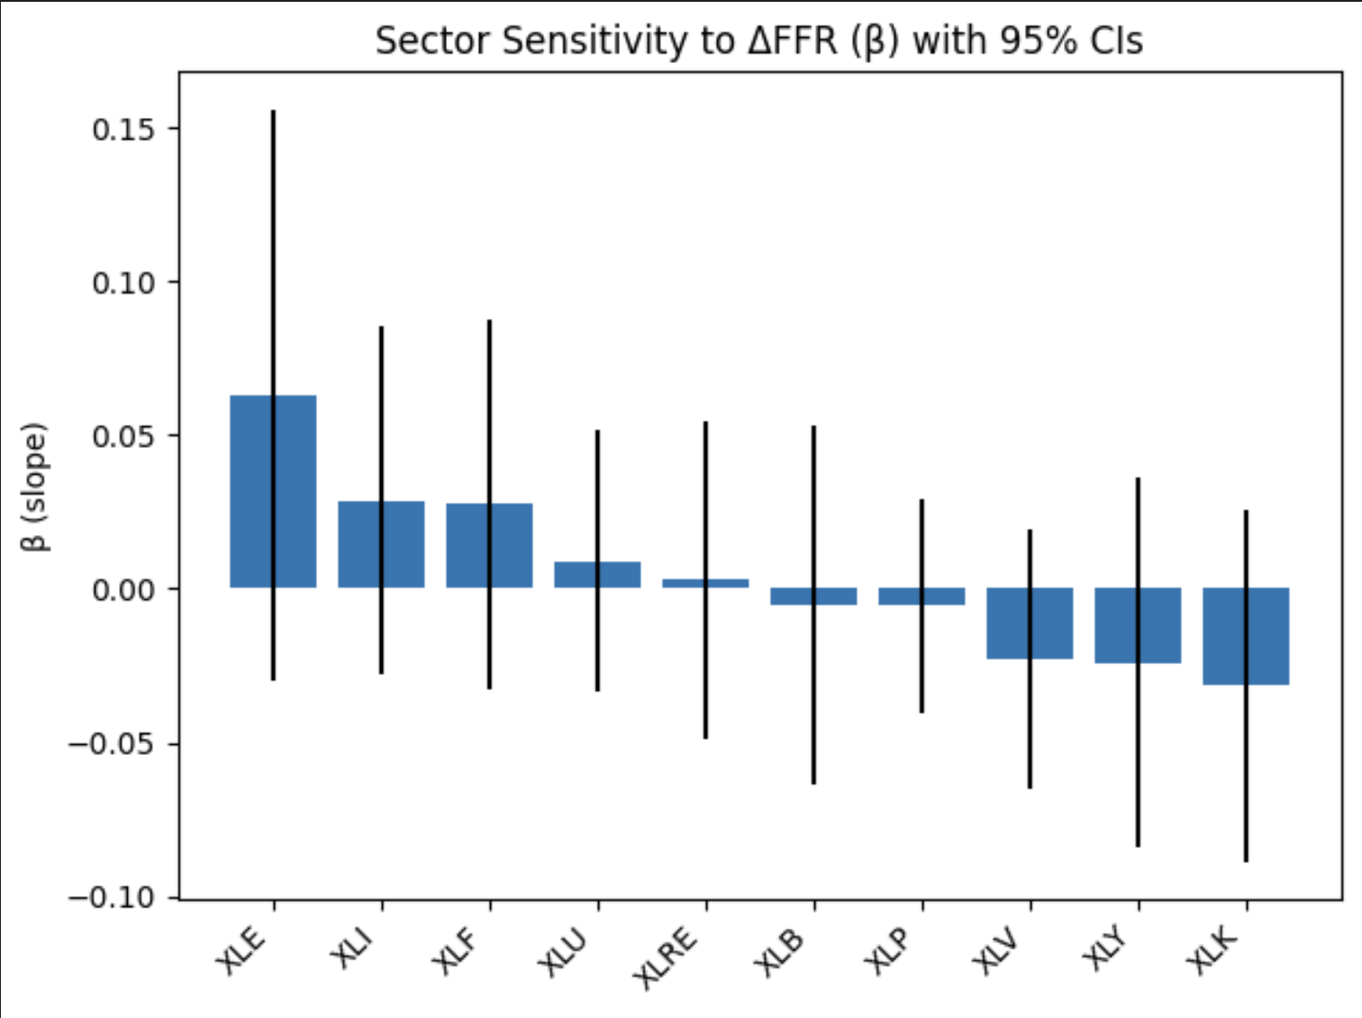
β Coefficients (ΔFFR → Returns)
Energy top
Tech negative
CIs

Slide 7
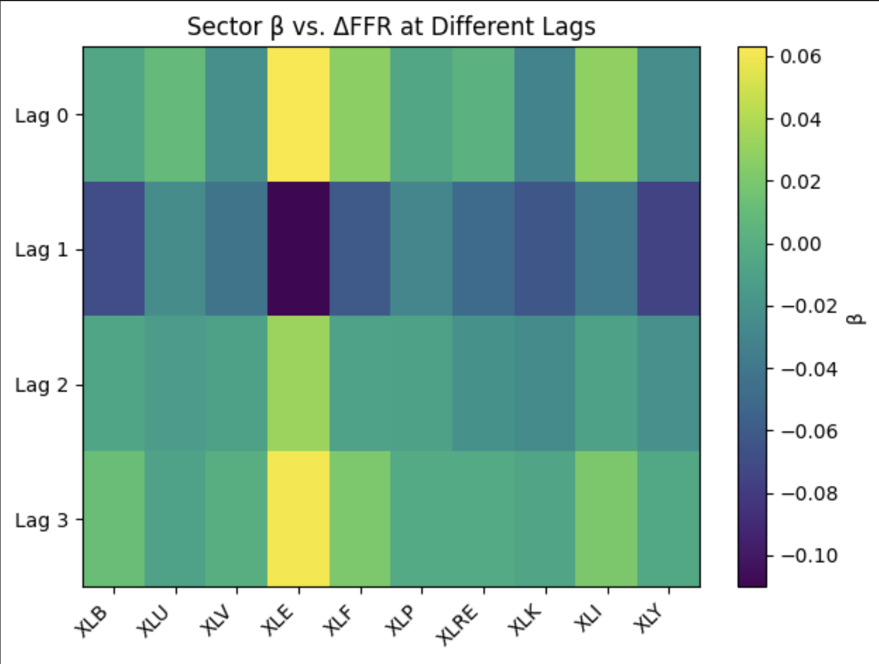
Timing Matters
After 1 month, effects fade/flip

Slide 8
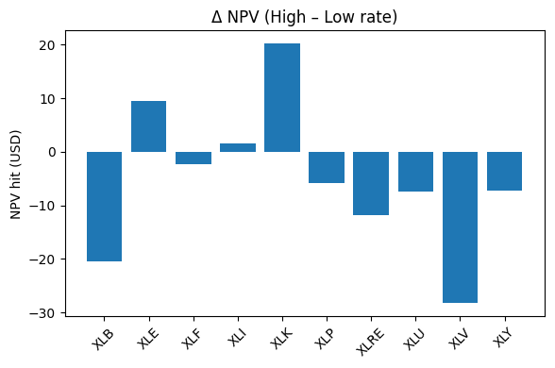
Applying NPV
Tech and Energy thrived long-term in high rate environment
Healthcare not so much
Notes:
Valuation compression is almost universal
- Even where raw returns stay positive, the higher discount rate turns most NPVs negative. That’s the textbook “higher cost of capital → lower present value”

Slide 9
Key Stock Takeaways
Rate shocks are brief: most sectors react within a month of a rate hike, but the effect fades by month 3
Cyclical sectors swing hardest: Energy, Industrials, Financials react sharply; safer sectors (Staples, Utilities, Healthcare) stay calm
Correlations to ΔFFR are small (< 0.1) and rarely significant—rates explain little of returns
Higher rates hurt NPV for rate‑heavy sectors (Utilities, Real Estate, Consumer), yet can boost cash‑rich ones like Energy

Slide 10
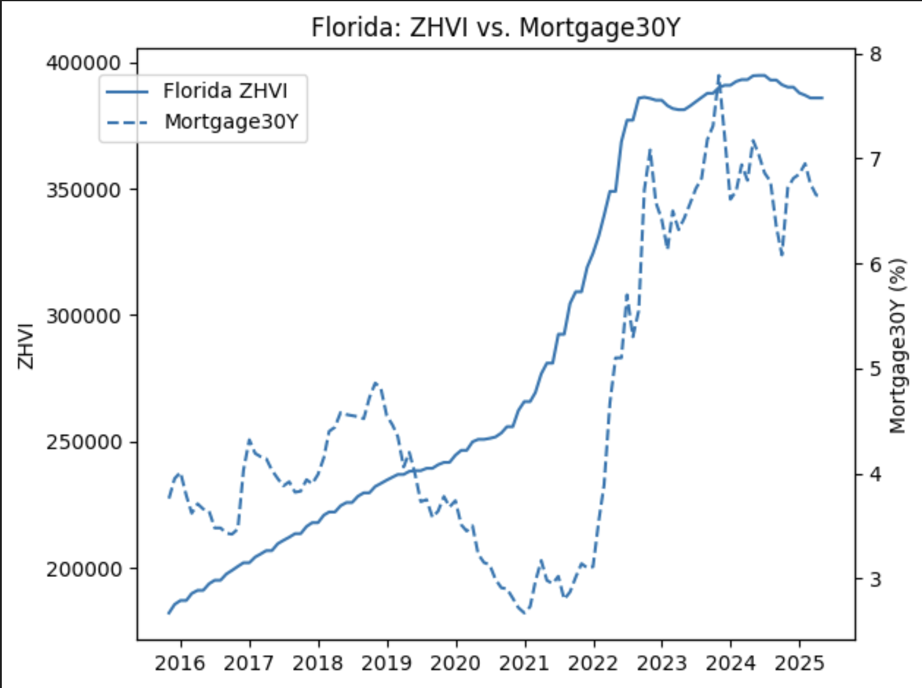
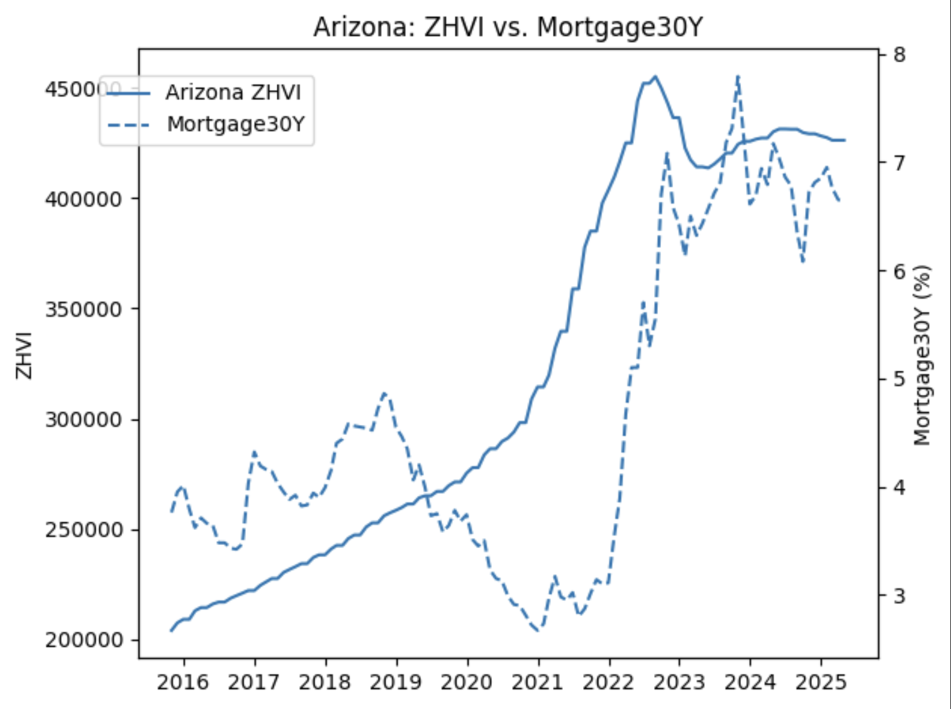
HOUSING VS. RATES – FIRST LOOK

Slide 11
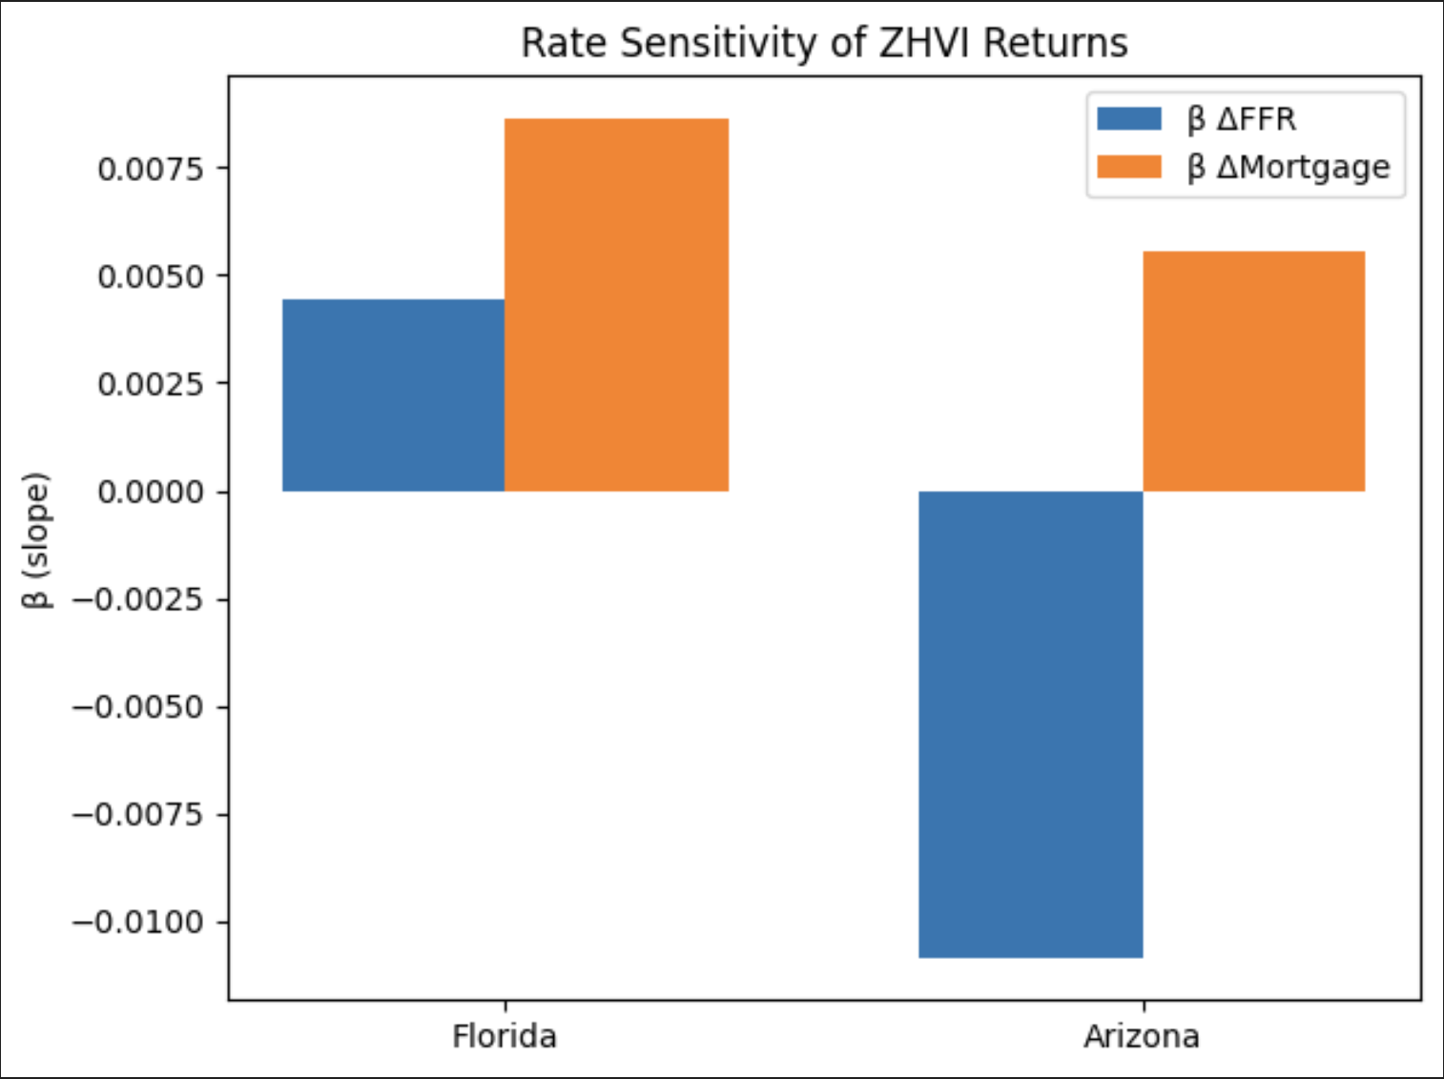
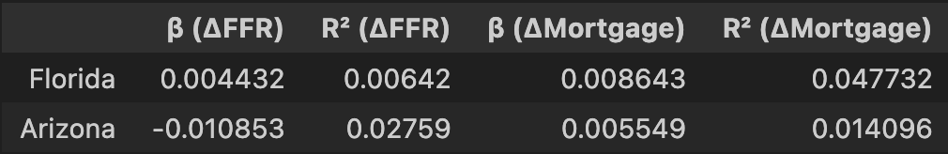
SIMULTANEOUS SENSITIVITY
impact on ZHVI returns
R² values

Slide 12
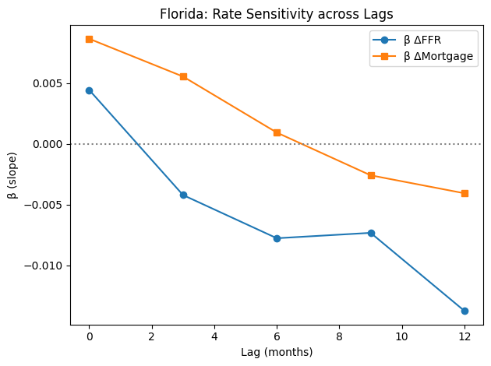
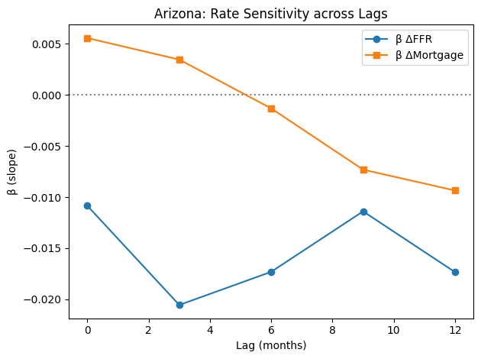
Lagged Effects (0-12m)
Sign flips over time – Florida’s ΔFFR beta goes from mildly positive at time-zero to negative by 6–12 months
Arizona is rate-sensitive immediately (negative β at lag 0) and remains negative.
Mortgage-rate betas start positive (prices rise with rate cuts), but both states turn negative within a year

Slide 13
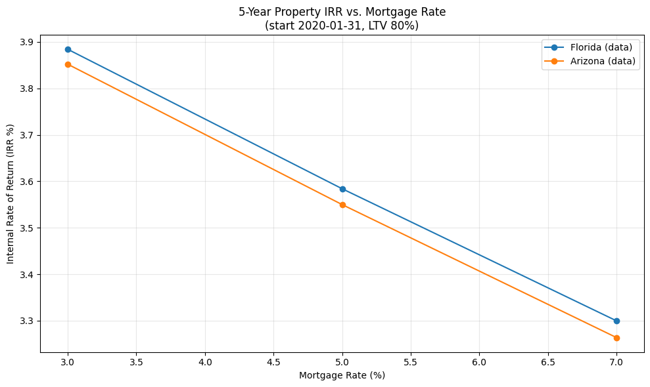
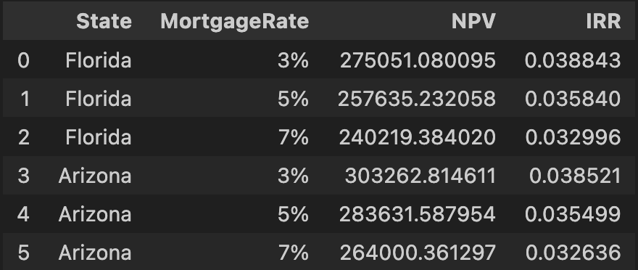
NPV and IRR
Florida: -0.1462 % IRR per 1% mortgage rate change
Arizona: -0.1471 % IRR per 1% mortgage rate change
Even small rate hikes can noticeably shrink investor returns
Both states are impacted similarly, suggesting a broad sensitivity
NPV decrease across both as mortgage rates increase
Rate hikes don’t just affect asset prices, but future profits

Slide 14
Limitations
Monthly aggregation obscures announcement‑day volatility.
Housing cash‑flow simplifications:
The model assumes investors only pay interest on the mortgage—not the loan principal
The model doesn’t include other real-world housing costs.
Low R² (≤1 %) indicates the regression model explains very little of the total variation in housing prices

Slide 15
Takeaways
Sector stocks react fast—but briefly—to Fed moves
Rates explain surprisingly little of monthly equity performance
Sun‑Belt housing is rate‑sensitive, but in different ways
Mortgage costs hit profitability hard

